Slide 1

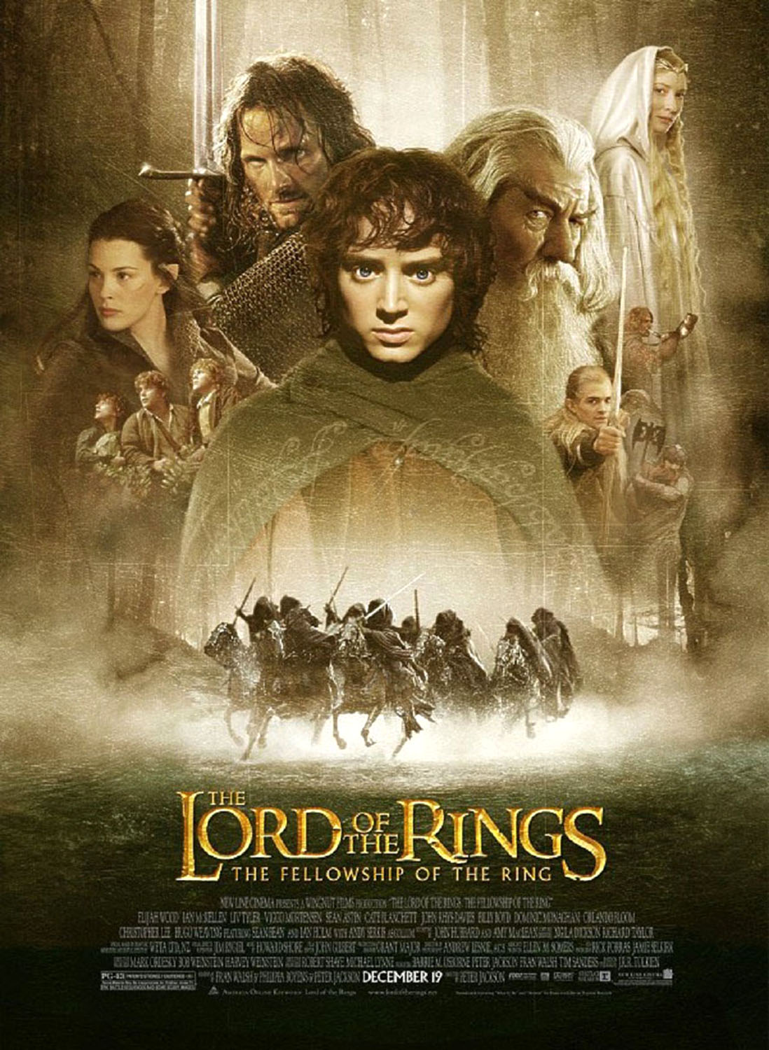
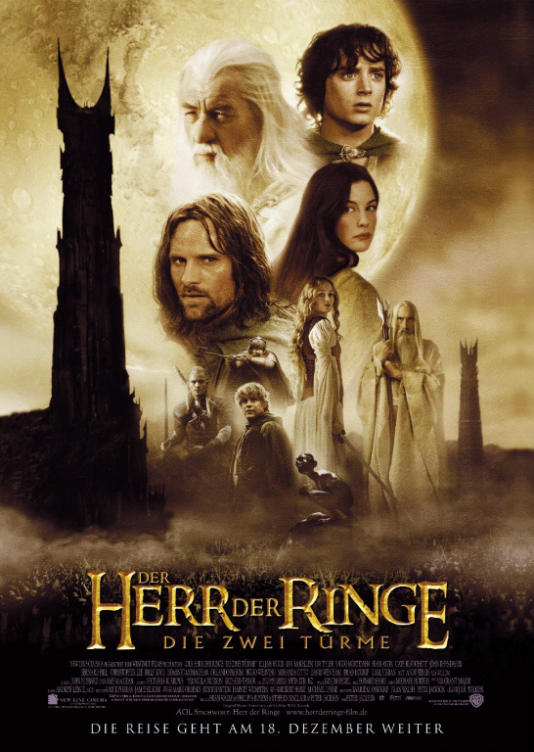
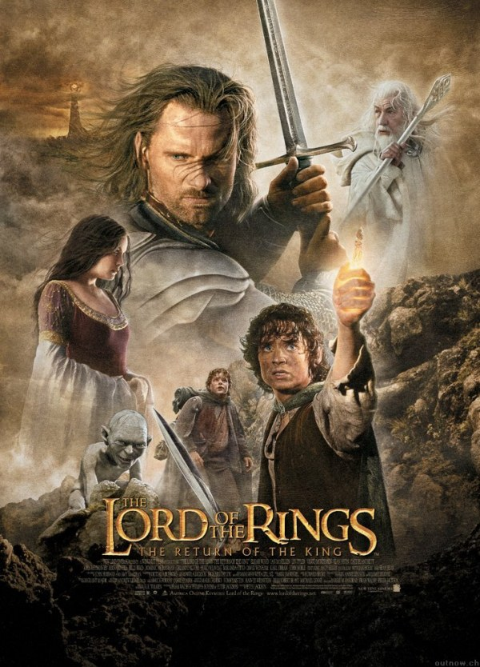
Notes:
The Lord of the Rings movie trilogy was filmed entirely in New Zealand.

Slide 2
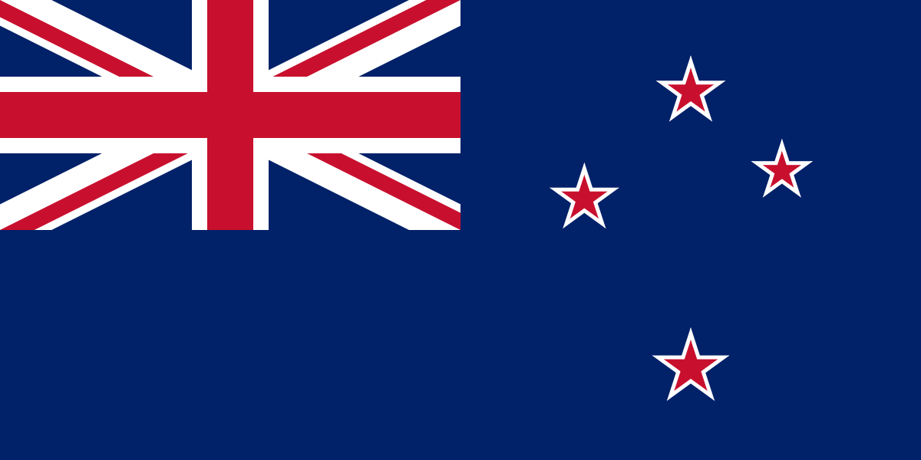
New Zealand
翻译1901
孟庆丰 范亚文

Slide 3
Unit 1
The Land and the People

Slide 4
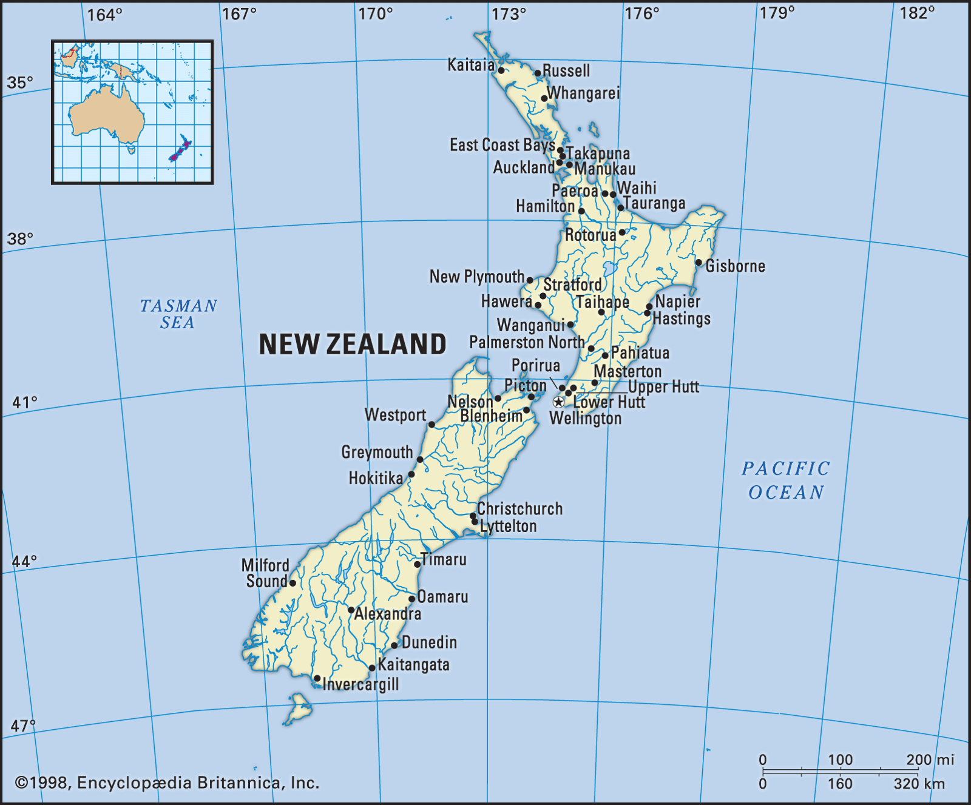
Geographical Features
Position:
New Zealand is located in the southwestern Pacific Ocean, midway between the Equator and the South Pole.
Size:
Similar in size to Japan or Britain, New Zealand occupies a land area of 270,500 square kilometres.
Composition:
New Zealand is composed of two main islands, namely the North Island and the South Island.
The geographic features of them differ greatly from each other, so much so that they deserve separate discussion.

Slide 5
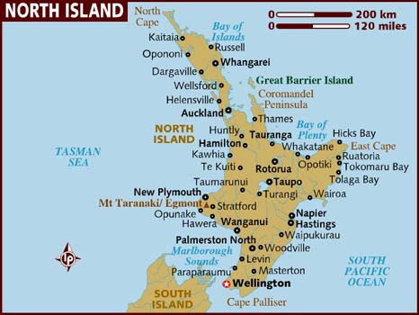
Geographical Features
The North Island has an area of 115,000 square kilometres.
It is divided into four provincial districts: Auckland, Taranaki, Hawkes Bay and Wellington.
It has the two most populous cities in the country: Wellington, the capital, and Auckland, the largest city in New Zealand
Features
1.Many volcanoes on the North Island.
2.There are a large number of rivers.
3.Lakes also abound in the North Island.

Slide 6
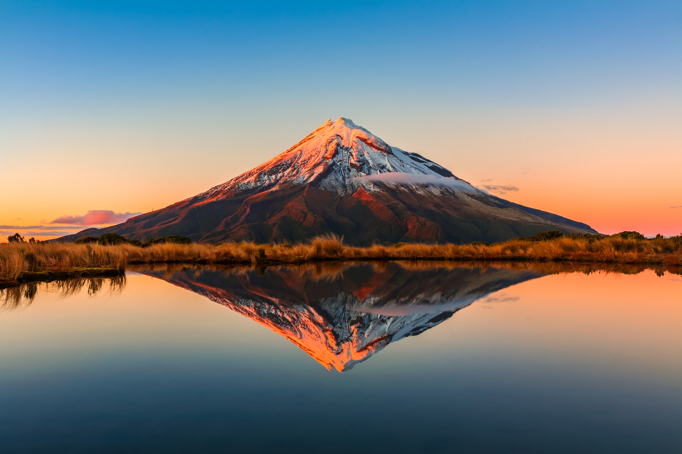
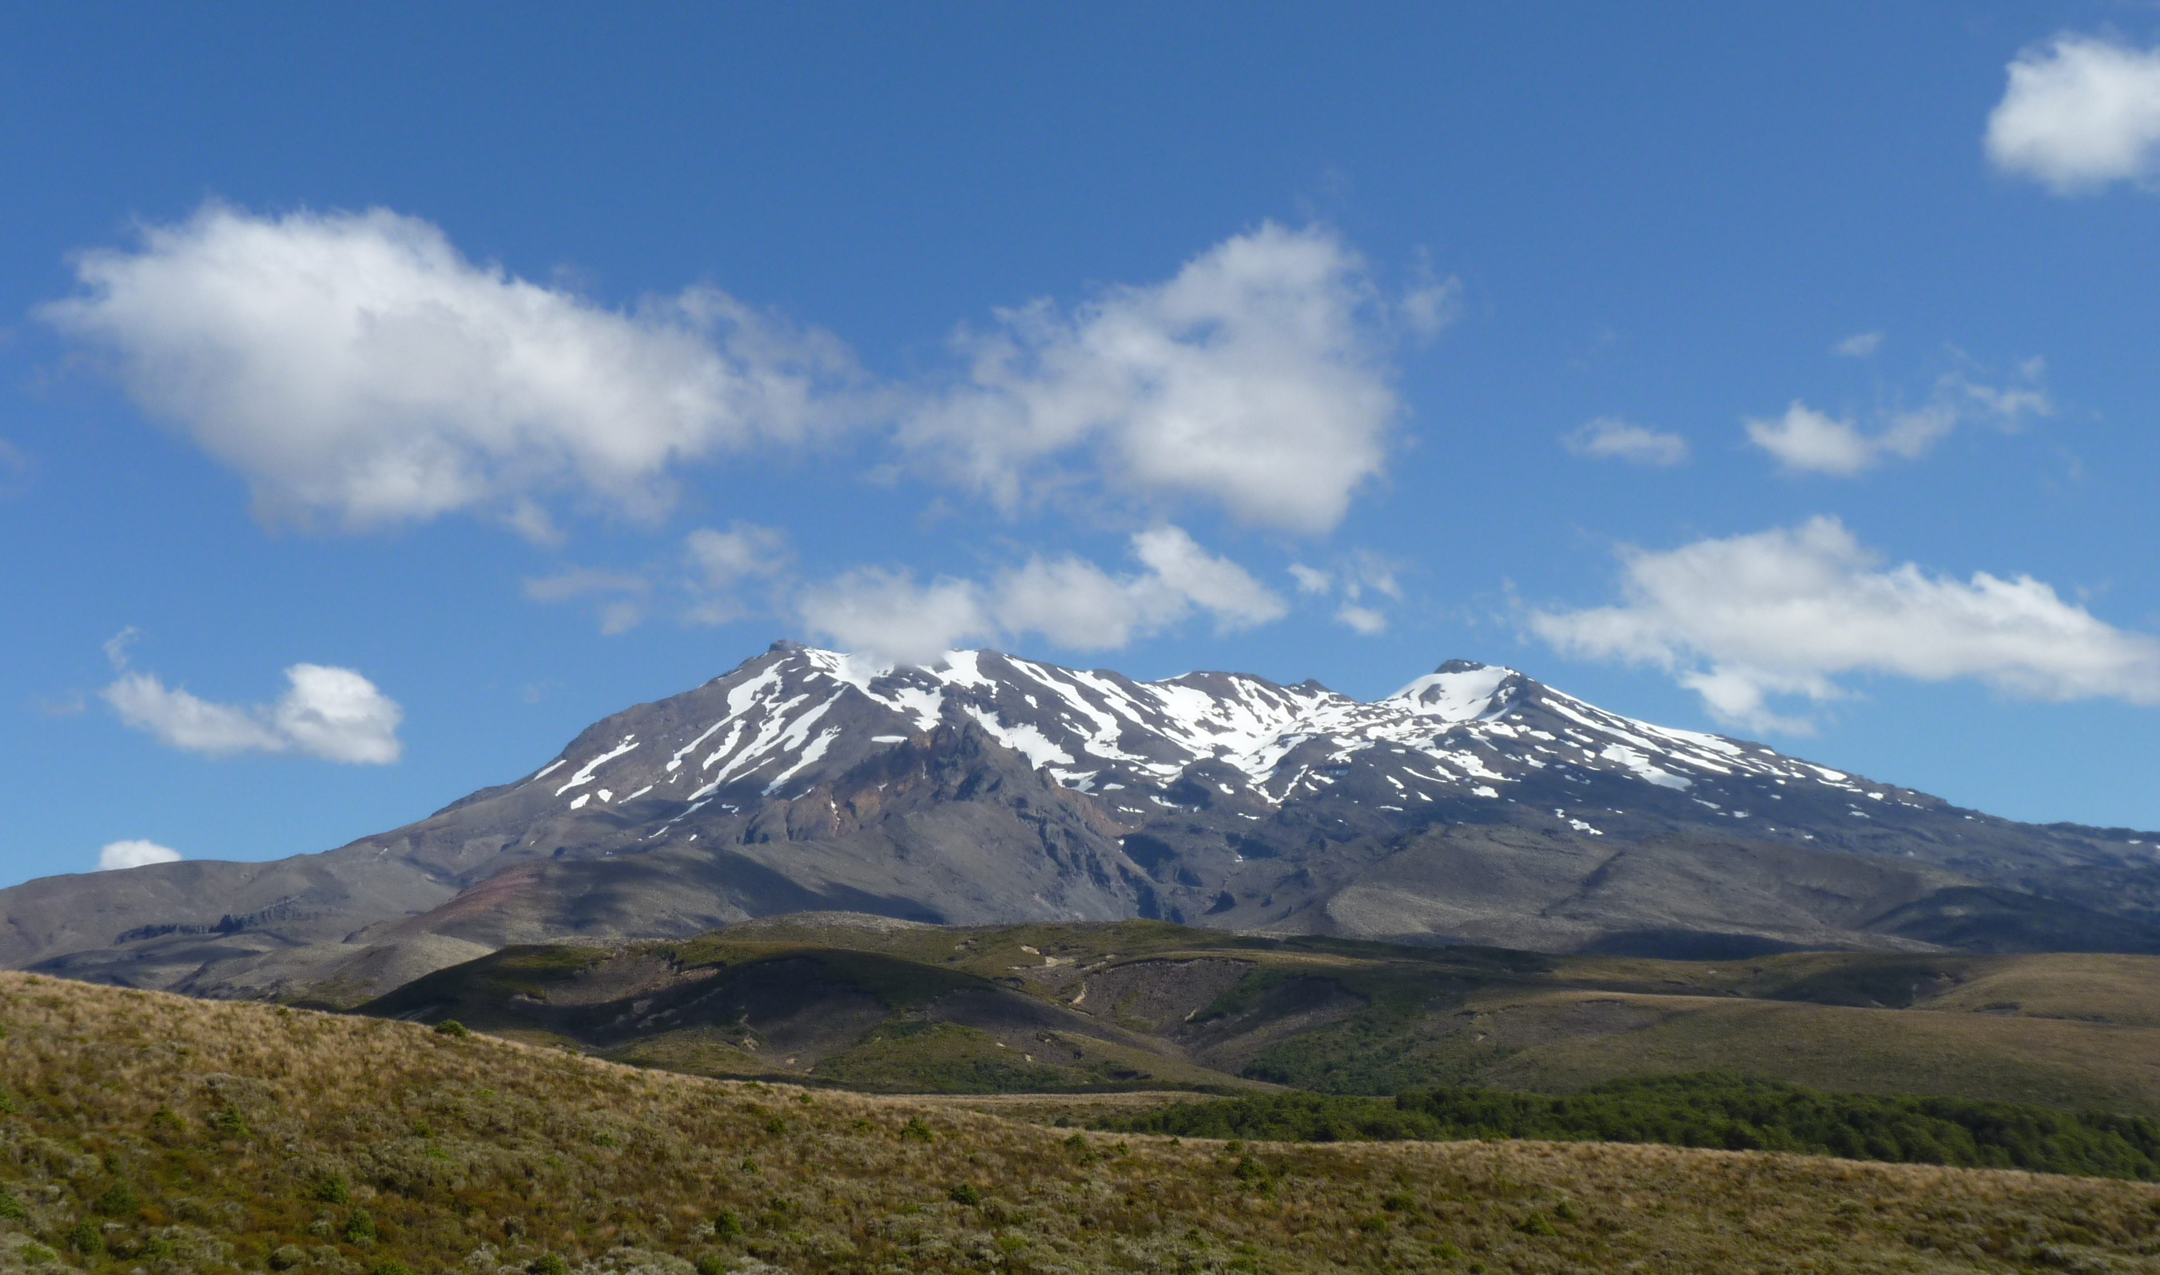
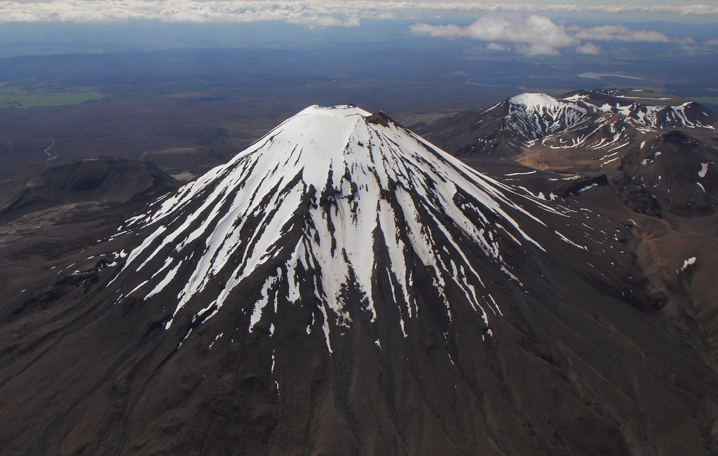
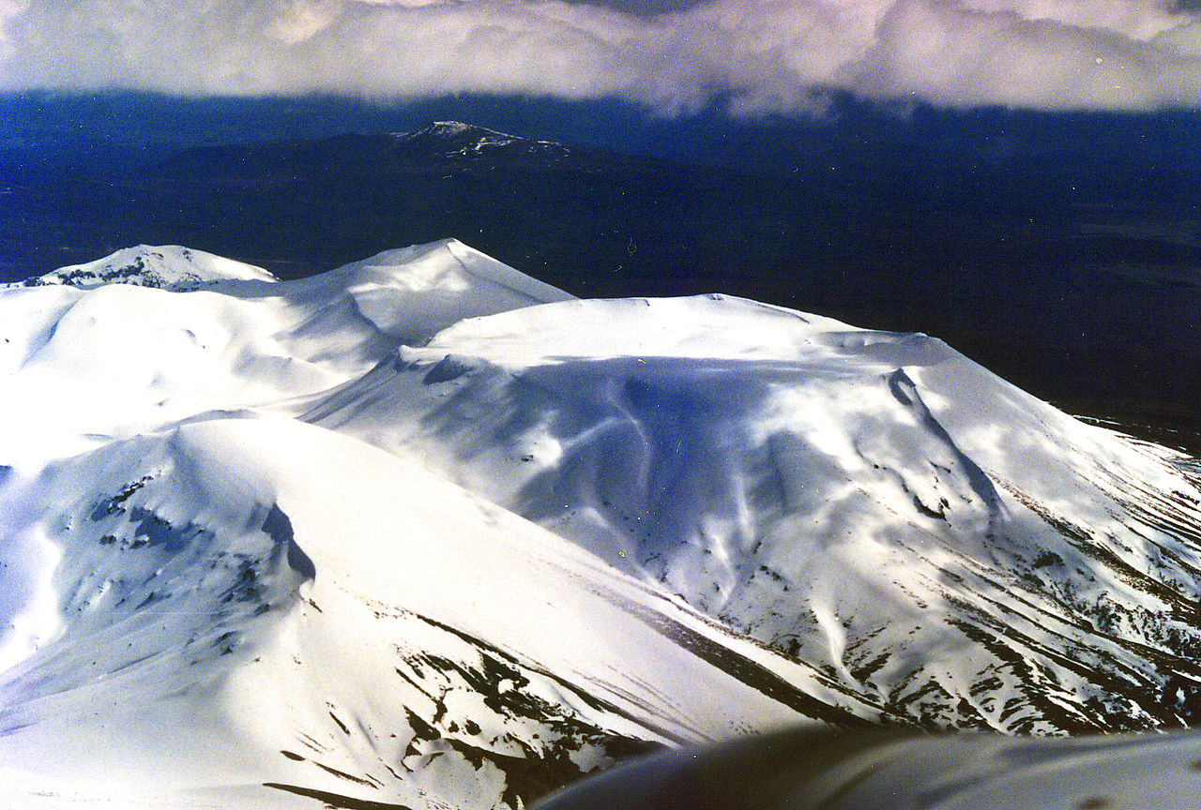
Geographical Features
Mount Egmont
Mount Egmont is the best known extinct volcano in New Zealand, due to its symmetrical shape.
It lies in Taranaki Province near the west coast.
The mountain is 2,518 meters high and has one of the most perfect cone-shaped peaks in the world
Mount Ruapehu
Mount Ruapehu is the highest mountain in the North Island (2,797 m). This volcano is still active, with its most recent eruptions occurring in 1995, and again, in 1996.
Altogether, there are four main active volcanic mountains in the North Island
Mount Ngauruhoe
Northeast of Ruapehu is the almost symmetrical cone of Ngauruhoe.
Mount Tongariro
The smallest and northernmost volcano (1,967 m), which contains several craters.

Slide 7
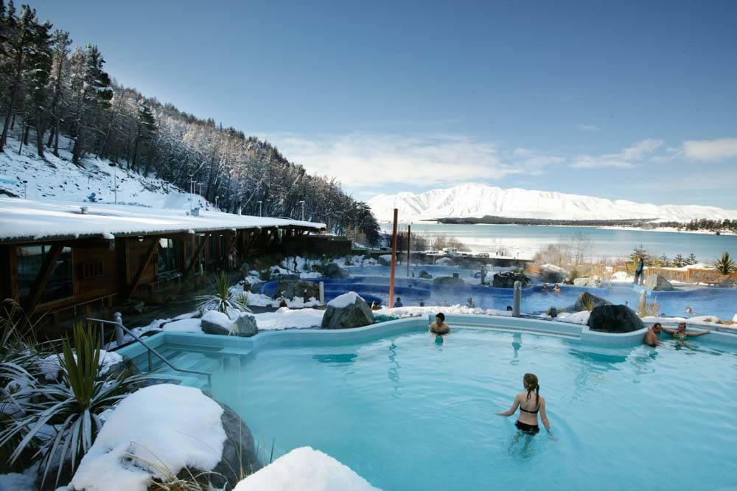
Geographical Features
Hot springs and geysers
Due to the repeated volcanic activities, the North Island is rich in the resource of geothermal power. Plenty of hot springs and geysers could be found here as a result of the underground heat.

Slide 8
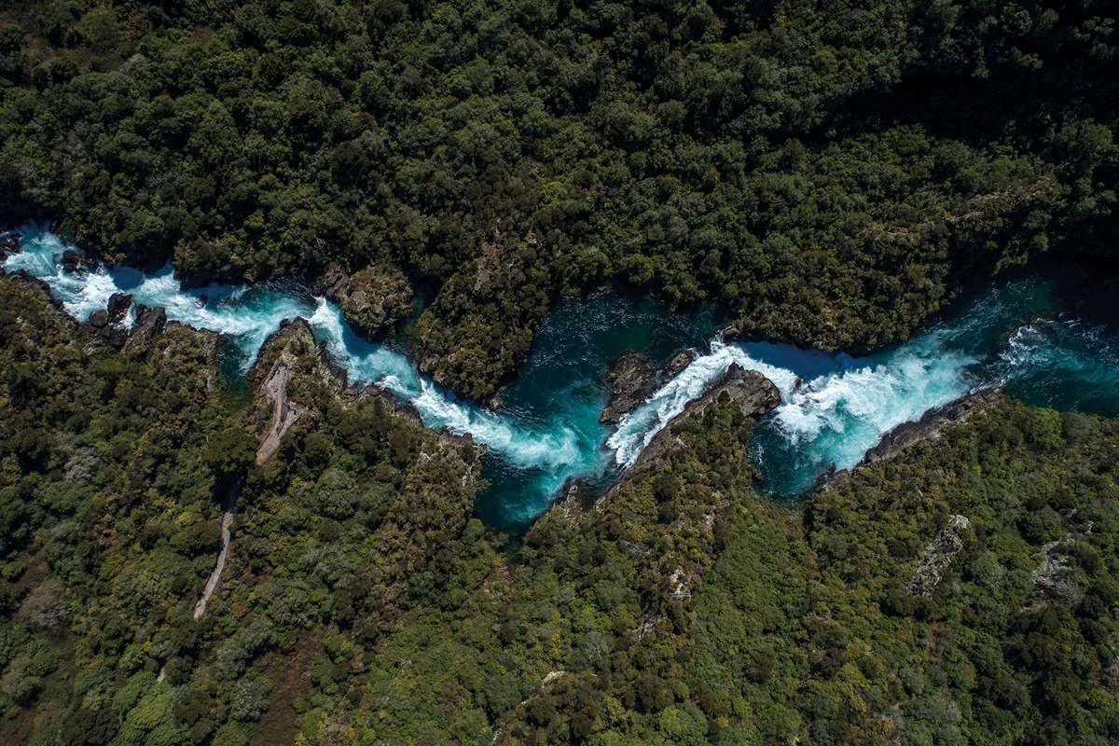
Geographical Features
Rivers
Within the North Island, there are a large number of rivers, most of which are short and swift. They rise in the east ranges of the North Island and flow into Hawkes Bay.
The 425-kilometer Waikato river is the longest river in New Zealand.

Slide 9
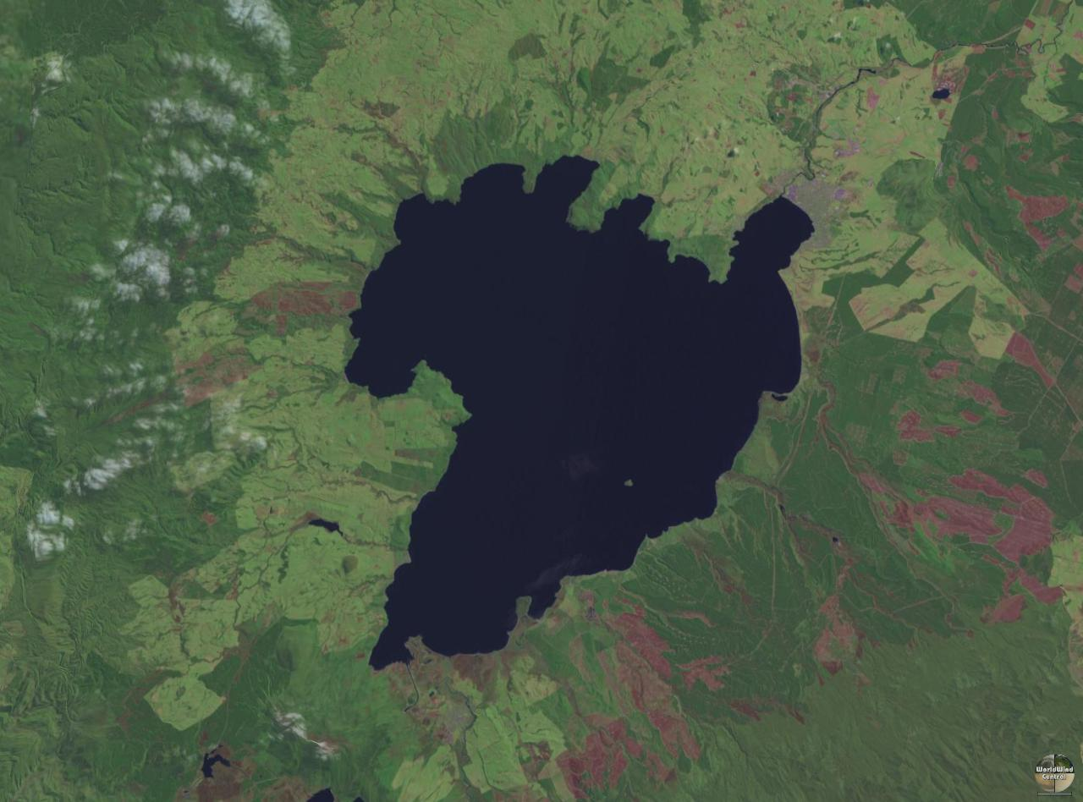
Geographical Features
Lakes
Lakes also abound in the North Island. The reason for their formation has to do with volcanoes.
Lake Taupo is the largest lake in New Zealand. It is 40 kilometres long and 27 kilometres wide.

Slide 10
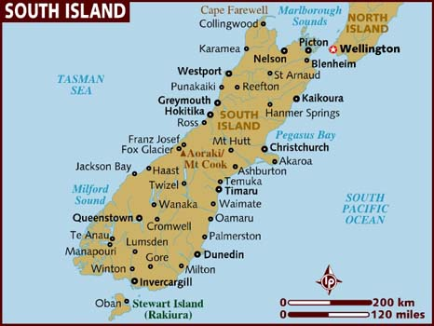
Geographical Features
The South Island has an area of 150,461 square kilometers, the largest of all the islands of New Zealand.
Features
1.The most impressive mountains in New Zealand are in the South Island.
2.South Island also has many other natural wonders, such as glaciers, lakes and rivers.

Slide 11
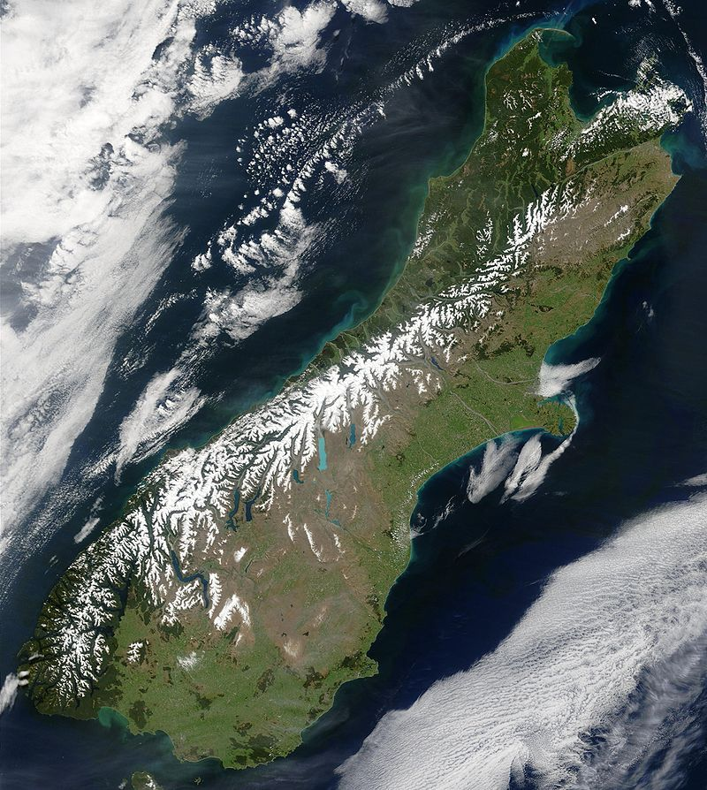
Geographical Features
Mountains
The Southern Alps are a range of mountains that extend almost the whole length of South Island of New Zealand.
Mount Cook is the highest peak in New Zealand.

Slide 12
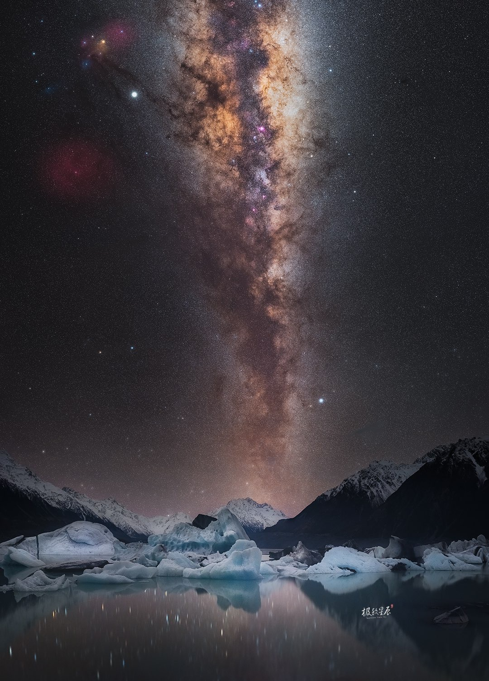
Geographical Features
Glacier
Different from the volcanoes and hot springs in the North Island, the South Island is famous for its more than 360 glaciers. Among them, the 29-kilometer long Tasman Glacier is the largest and most impressive.
Glacial activity in the Southern Alps has resulted in the formation of many lakes.
Most of the rivers of the South Island originate in the glacial lakes.

Slide 13
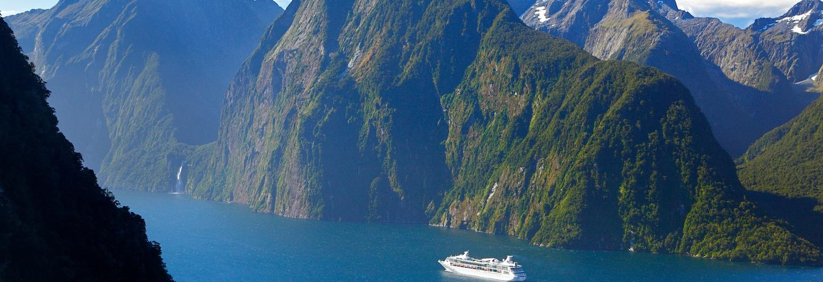
Geographical Features
New Zealand has an exceptionally long coastline compared to the size of the country (about 15,134 km).

Slide 14
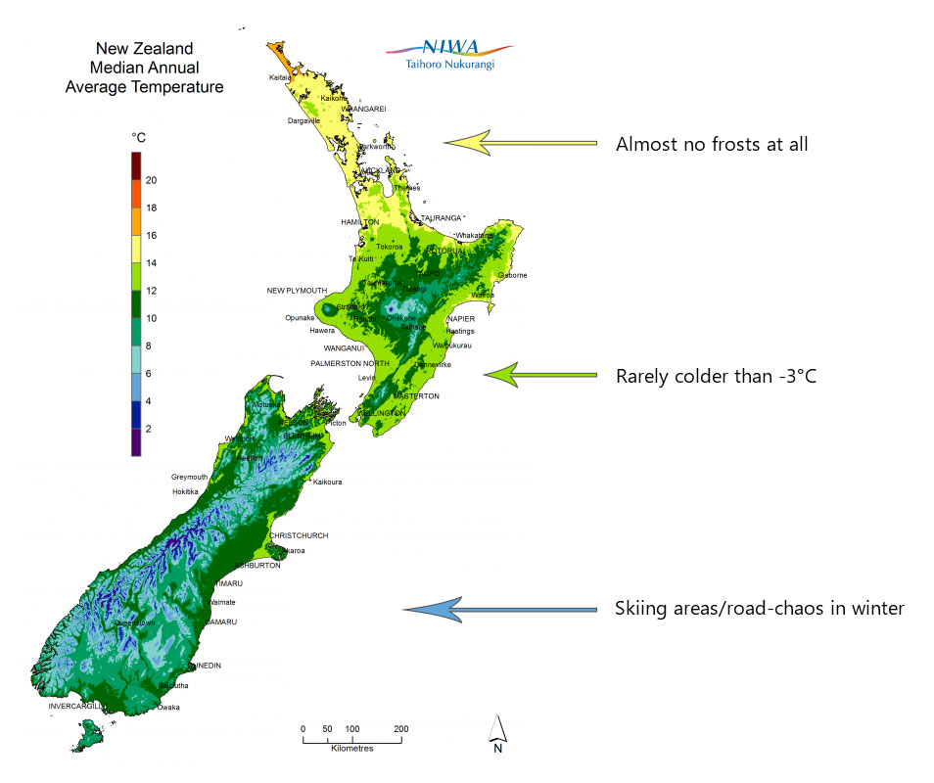
Geographical Features
Climate
New Zealand has a typical maritime climate.
It has mild temperatures, moderately high rainfall, and many hours of sunshine throughout most of the country.
Its climate is dominated by two main geographical features – the sea and the mountains.
Because of all this, New Zealand’s weather tends to be very changeable.

Slide 15
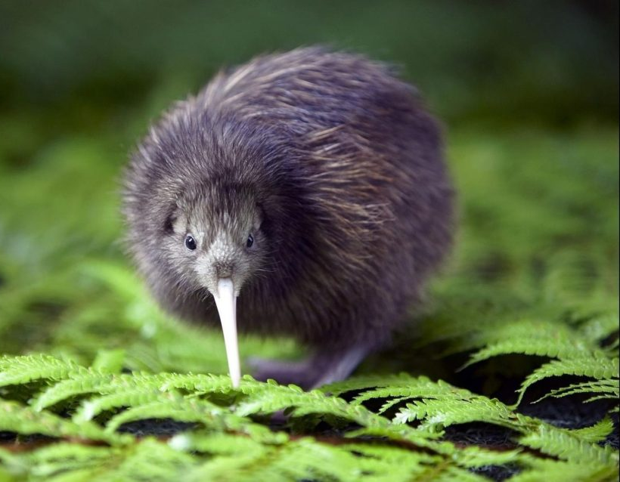
Geographical Features
Plants and animals
According to geochronology, the islands which form today’s New Zealand drifted away from an ancient land mass into the South Pacific and became isolated from the rest of the world.
Since then, a large number of plants and animals have evolved to be so unique that they can only be found in New Zealand.
In this sense, New Zealand is sometimes referred to as an “ultimate storehouse for discontinued zoological models”

Slide 16
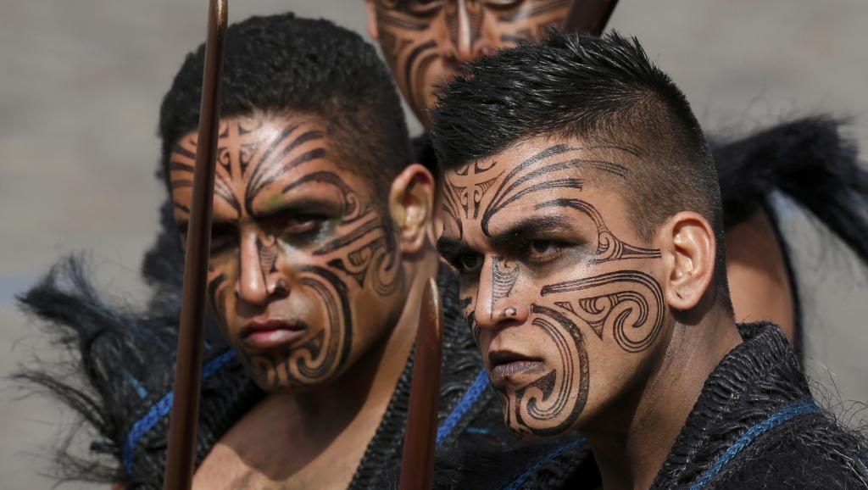
People
Population and immigration
About 80 per cent of New Zealanders are of European descent. They are often known by the Maori name Pakeha.
Maori, the original inhabitants of New Zealand, are the largest non-European group.
Pacific Islanders and East Asians account for about 6.5 and 6.6 per cent of the population respectively.
New Zealand is positive about immigration and is committed to increasing its population by approximately 1 per cent per year.

Slide 17

People
Language and religion
English and Maori are the official languages of New Zealand. Other Polynesian and European languages are spoken by a small percentage of the population.
New Zealand has no state religion. Religious belief is a matter of personal choice. Nearly 40 per cent of the population claim to have no religious affiliation.

Slide 18
Unit 2
History and the Present

Slide 19
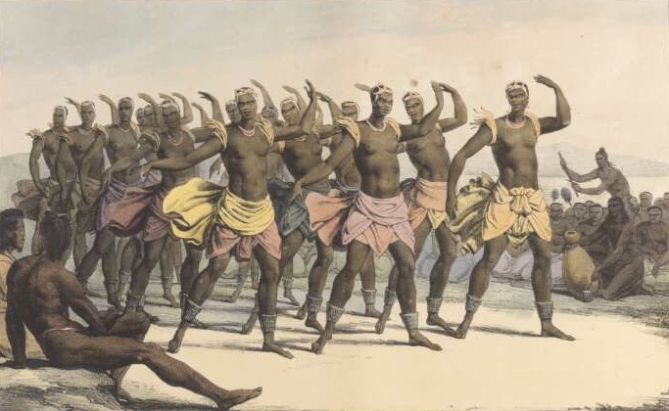
History
First settlers
The first “discoverers” of the New Zealand is Polynesians. They created a distinct culture and became known as the Maori.
European explorers
The first Europeans known to reach New Zealand were the crew of Dutch explorer Abel Tasman. Newcomers are called as pakeha (“foreign”).
Treaty of Waitangi
In an effort not to lose their land and forests to the newly arrived foreigners, they made the decision to seek protection from Britain.
On 6 February, Maori chiefs signed New Zealand’s founding document, the Treaty of Waitangi

Slide 20
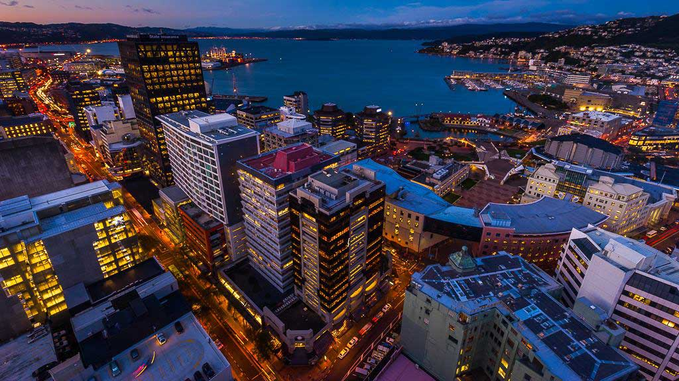
History
Growth of a nation
In 1852, under the UK Parliament’s New Zealand Constitution Act, New Zealand was granted self-government.
The Maturing of the nation
In 1947, New Zealand gained its full independence from Britain.
Since 1884, successive governments have implemented far-reaching economic reforms.

Slide 21
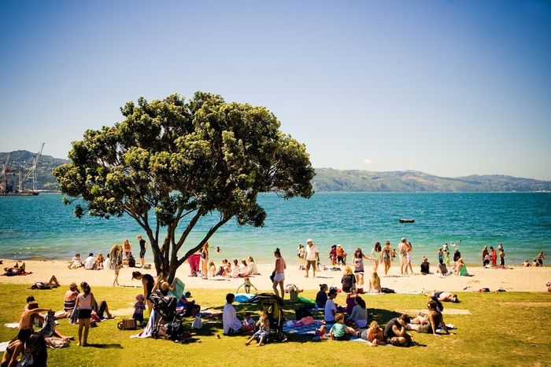
Life in New Zealand Today
New Zealand is not only the fresh air and abundant sunshine, but also the lifestyle and culture that make it such a unique country.
Way of life and social values
“Kiwis” are known for being passionate about sports.
Some of the most popular leisure activities among New Zealanders, therefore, include beach swimming, fishing.
Another “kiwi” characteristic is the people’s firm belief in social equality.
The informality and friendliness could also be felt in the workplace.
Maoritanga
Maoritanga is Maori culture: a way of life and a view of the world.

Slide 22

Education
New Zealand has high levels of educational achievement.
Early childhood education
Early childhood education, which is available for children aged from 0 to 5 years, is non-compulsory in New Zealand.
Primary and secondary school education
Compulsory education in New Zealand includes both primary and secondary school education, which covers 12 years, usually from ages 6 to 16, although schooling is available to children from age 5.
Tertiary education
The term “tertiary education” in New Zealand is used to describe all aspects of post-secondary education and training

Slide 23
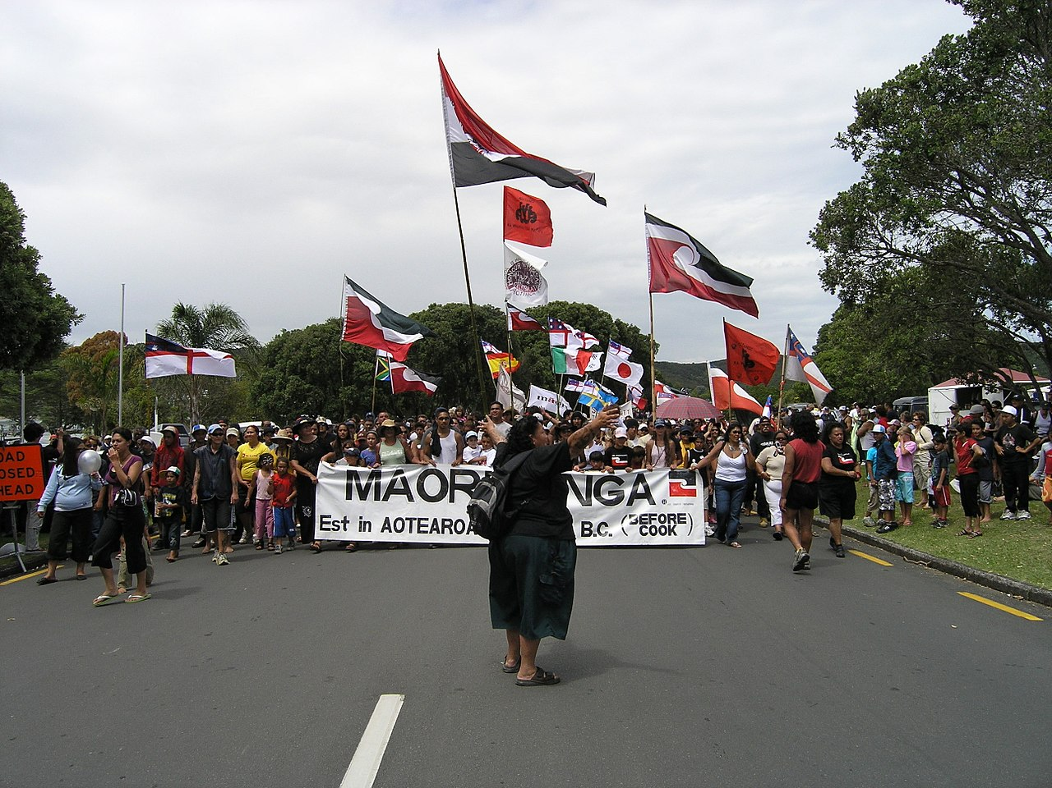
Holidays and Celebrations
Holidays and Celebrations
The official public holidays of New Zealand include New Year’s Day, Waitangi Day, Easter and so on.
All in all, these Western and Native holidays and festivals keep reminding New Zealanders that they are a nation of immigrants as well as a nation of great diversity.

Slide 24


